Slide 1
Renewal of Substance Use Disorder (SUD) Fee for Service (FFS) Contract with
NJ Department of Human Services
Division of Mental Health & Addiction Services (DMHAS)
April 27, 2021

Slide 2
SUD FFS Remote Contract Renewal
Executive Directors were e-mailed a detailed letter regarding the SUD FFS SFY 2022-2023 contract renewal remote process
Contract documents must be uploaded to a secure FTP site no later than COB on Tuesday, May 25, 2021
The following presentation should assist staff in completing and submitting the required documents
Any questions can be directed to Catherine Spencer, SUD FFS Contract Liaison via e-mail
Catherine.Spencer@dhs.nj.gov

Slide 3
Table of Contents SUD FFS Contract Renewal
Document Name Slide #
Where to find the documents on NJSAMS 5
SUD FFS Network Provider Checklist 6-7
Agency Administrative Information and Signature Page SUD FFS SFY 2022-2023 8
Annex A – Contract Boilerplate 9
Annex A1 – Level of Care specific 10
Annex A2 – Initiative specific 11
Annex A3 – Enhancement specific 12
DHS Standard Language Document 13
DHS Business Associate Agreement 14
Board Resolution Form w/Authorized Signatures 15-16
Public Law 2005, Chapter 51* (Formerly Executive Order 117) 17-18
Public Law 2005, Chapter 271* 19

Slide 4
Table of Contents SUD FFS Contract Renewal
Document Name Slide #
N.J.S.A. 52:34-13.2 Source Disclosure Certification (formerly EO 129) 20
Certification Regarding Disbarment & Suspension- Schedule G 21
Certification Sheet for Application for Contract Funds-Schedule I 22
AGENCY SPECIFIC DOCUMENTS list 23
AA 302 Certification of Employee Info Report (Affirmative Action Profile) 24, 25, 26
Insurance Declaration Page-Certificate of Liability Insurance 27
Business Registration Certificate from NJ Treasury 28
Also include documents listed on checklist specific to your agency, including your
Signed Site Summary – no slides are included
Upload Instructions 29

Slide 5
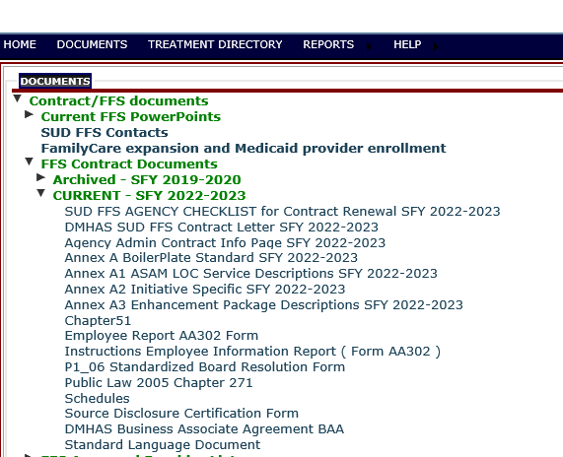
Access NJSAMS documents https://njsams.rutgers.edu/njsams/Documents.aspx
Contract documents can be accessed from NJSAM home page; no need to log in

Slide 6
SUD FFS Network Provider Checklist
Most forms can be found on NJSAMS
https://njsams.rutgers.edu/njsams/Documents.aspx

Slide 7
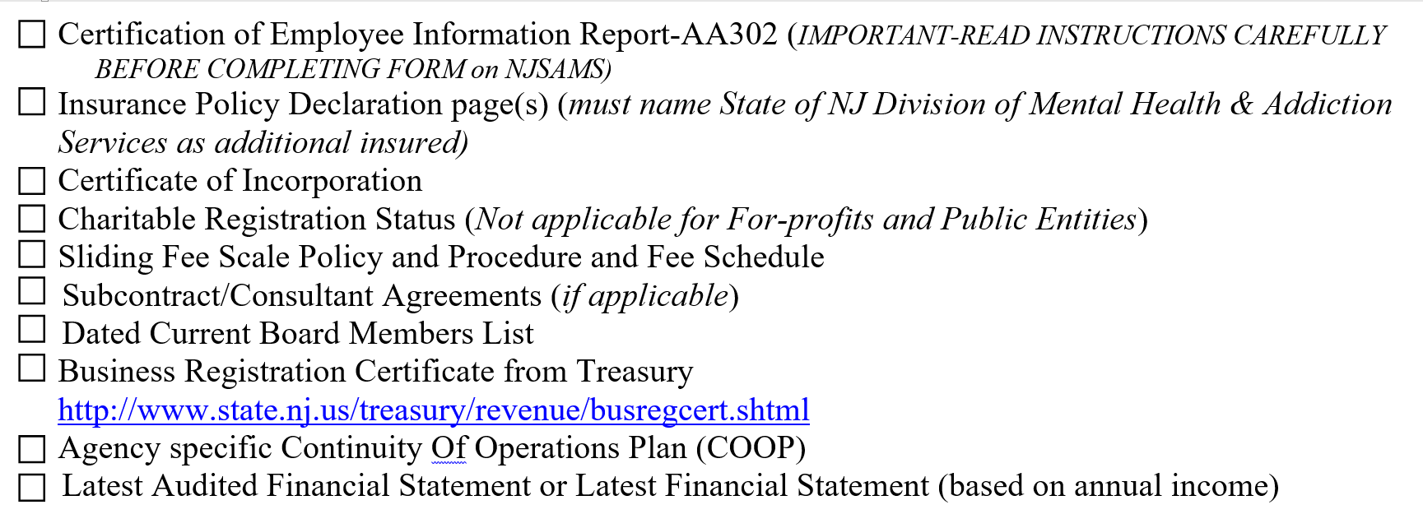
SUD FFS Network Provider Checklist – Agency Specific Documents

Slide 8
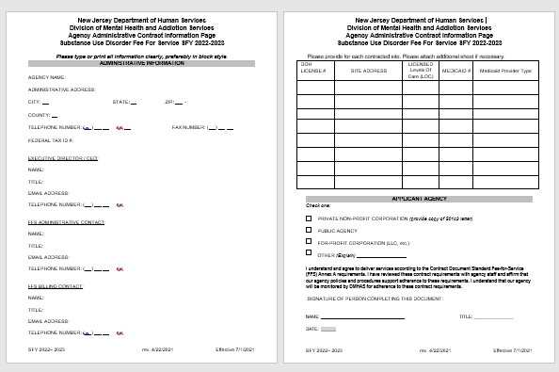
SUD FFS Contract Documents
Agency Administrative Contact Information Page SUD FFS SFY 2022-2023
Be sure this form is filled out completely and signed on page 2.
Identify three contacts with e-mails for correspondence regarding SUD FFS contracts, reminders for revised claim cutoff due to State holidays, etc.
Administrative contact, SUD FFS Administrative contact and Billing contact.
Providers are responsible for advising SUD FFS staff of revisions to contact staff and/or e-mails to ensure communication remains open during the contract period.

Slide 9
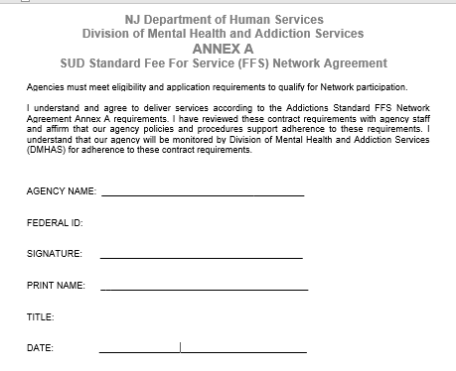
FFS Contract Requirements – Annex Documents
Standard Fee for Service Annex A (Standard Boilerplate)
Complete, Sign, date and convert to a PDF

Slide 10
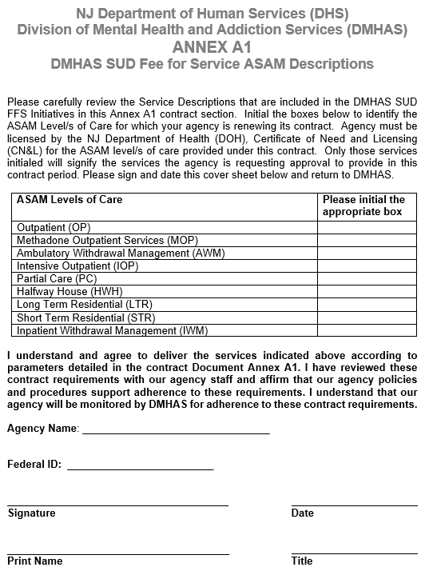
FFS Contract Requirements – Annex Documents Must be Submitted to DMHAS
Initial AND signature required
ASAM Service Descriptions [Annex A1]
Initial each block representing contracted licensed levels of care
Complete the bottom of first page, sign, date, convert to a PDF
This form should represent SUD FFS contracted levels of care based on your SUD FFS Site summaries, representing all contracted sites. One form per Federal ID /Contract # only.

Slide 11
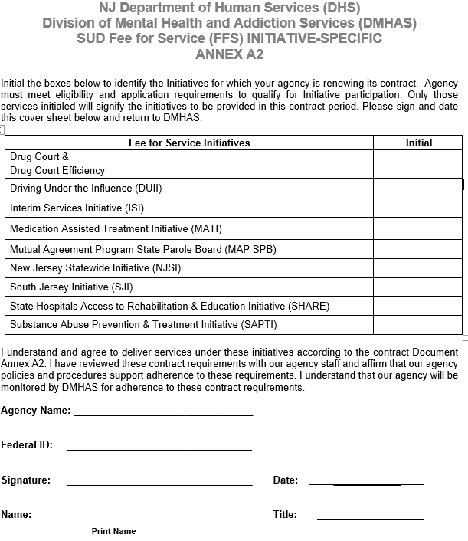
FFS Contract Requirements – Annex Documents
Initial AND signature required
ASAM Initiative Specific [Annex A2]
Initial each block representing contracted funding
Complete the bottom of first page, sign, date, convert to a PDF
This form should represent SUD FFS contracted Initiatives based on your SUD FFS Site summaries, representing all contracted sites. One form per Federal ID /Contract # only. All FFS providers must sign for Interim Services

Slide 12
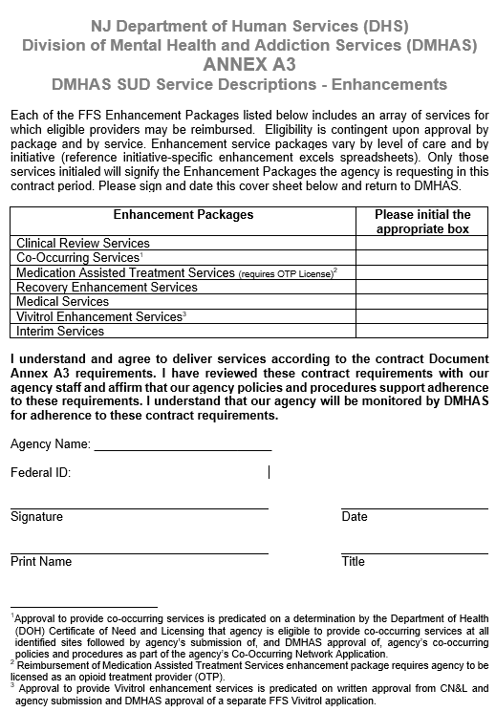
FFS Contract Requirements – Annex Documents
Initials AND signature required
ASAM Initiative Specific [Annex A3]
Initial each block representing contracted enhancements
Complete the bottom of first page, sign, date, convert to a PDF
This form should represent SUD FFS contracted enhancements based on your SUD FFS Site summaries, representing all contracted sites. One form per Federal ID /Contract # only. All FFS providers must sign for Interim Services enhancement.

Slide 13
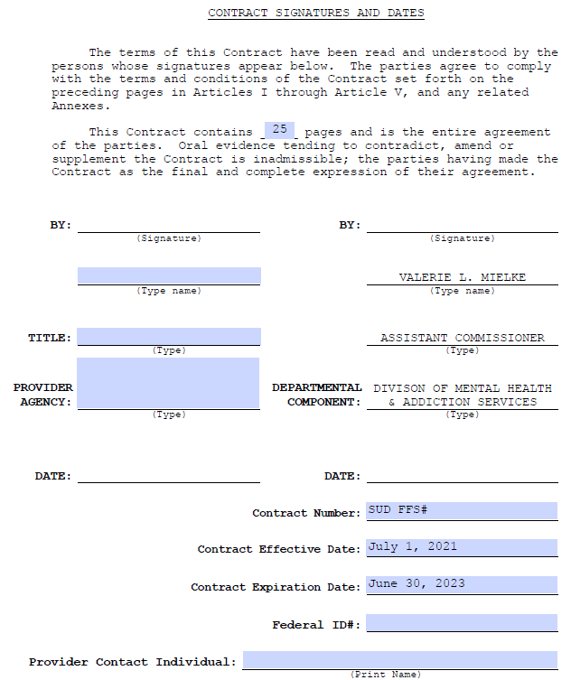
Standard Language Document
Page 25
Providers must enter their information on the left hand side.
At the bottom, please enter your contract # 22- (this # begins with 22-, then four digits specific to your agency, followed by –F) Your contract #can be found your site summary.
Effective Dates have been filled in
Enter Federal ID
Enter Provider Contact

Slide 14
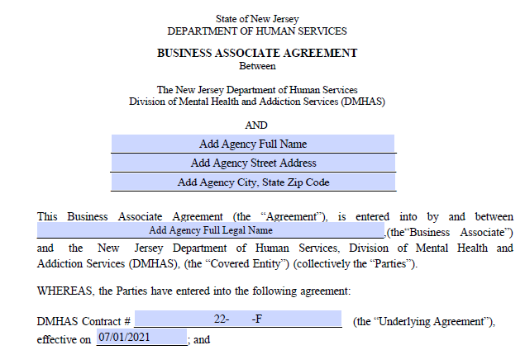
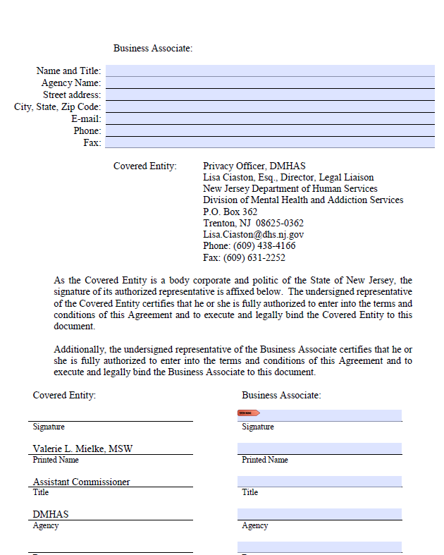
Helpful hints in preparing contract documents Business Associate Agreement common errors
Page 1 of 11
Providers neglect to enter their agency name and address, enter agency name again
Please enter your contract #22- (this # begins with 22-, then four digits specific to your agency, followed by –F) Your contract #can be found your site summary.
Effective Date July 1, 2021
Page 11 of 11
Providers to enter their agency name and other information at the top
Fill out the bottom right
once signed by DMHAS, providers will receive your copy with your executed contract

Slide 15
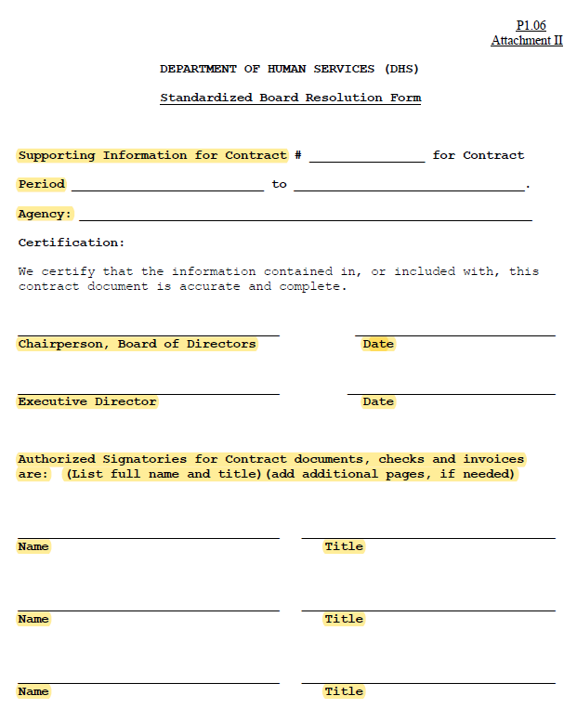
Board Resolution Form w/Authorized Signatures
Standard Board Resolution Form
A completed Standardized Board Resolution Form (signed by
either the President/Chairperson or Secretary for the Board) stating who is authorized to sign the Contract, and also addresses other contract commitments

Slide 16
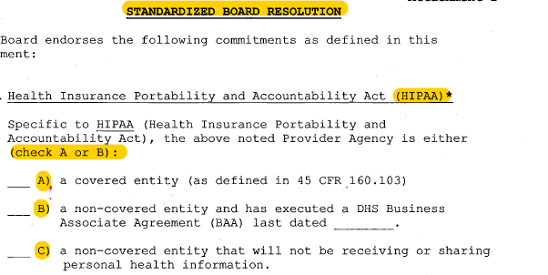
Standard Board Resolution Form
Standard Board Resolution Form, Page 2
Common error – providers neglect to chose from A or B

Slide 17
Chapter 51/Executive Order 117 page 1&2- please complete

Slide 18
Chapter 51/Executive Order 117 page 3

Slide 19
Chapter 271- please complete Contract Reference – enter contract #
18

Slide 20
Source Disclosure Certification Form Executive Order 129 Certification
Please complete form, entering your contract number under Solicitation Number

Slide 21
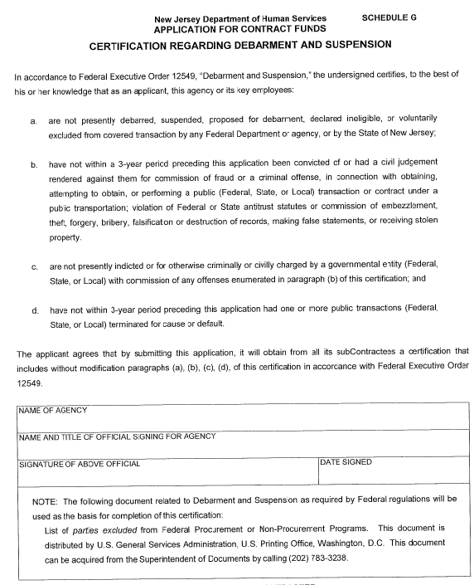
Schedule G
Please complete, sign and date the bottom

Slide 22
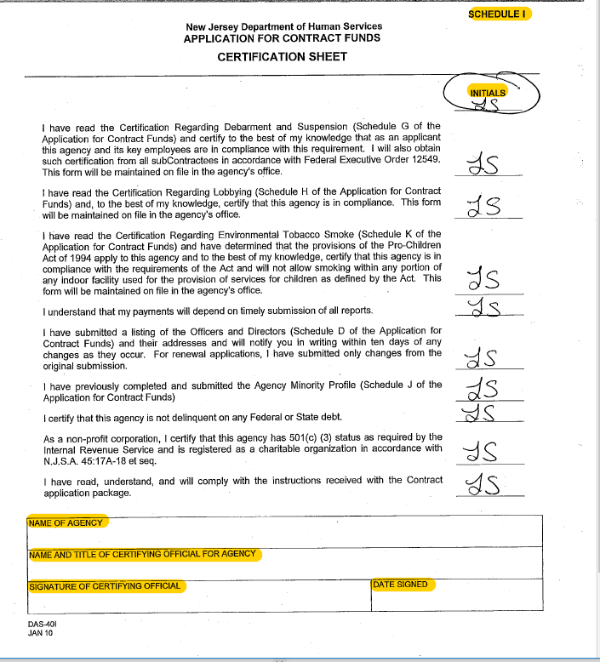
Schedule I
Please be sure to initial each line, complete, sign and date the bottom

Slide 23
FFS Contract Requirements – Must be Submitted to DMHAS-forms specific to your agency
Certificate Employee Information Report /AA302
Insurance Declaration Page (Certificate of Liability Insurance – must name the State of NJ (DMHAS) as additionally insured)
Certificate of Incorporation
Charitable Registration Status (copy of 501c Letter from the IRS or copy of letter from the State Attorney General’s Office)
Sliding Fee Scale Policy and Procedure and Fee Scale
Subcontract/Consultant Agreements (if applicable)
Dated Current Board Members List
Business Registration Certificate from Treasury
Continuity of Operations Plan (COOP
Latest Audit Financial Statements or Latest Financial Statements

Slide 24
Certificate of Employee Information Report AA302
Provide copy of current Certificate of Employee Information Report
If you do not have one, please access the form on NJSAMS and refer to next 2 slides.

Slide 25
Certificate of Employee Information Report AA302
Access the AA302 for from NJSAMS
Also included under Documents, please see detailed instructions

Slide 26
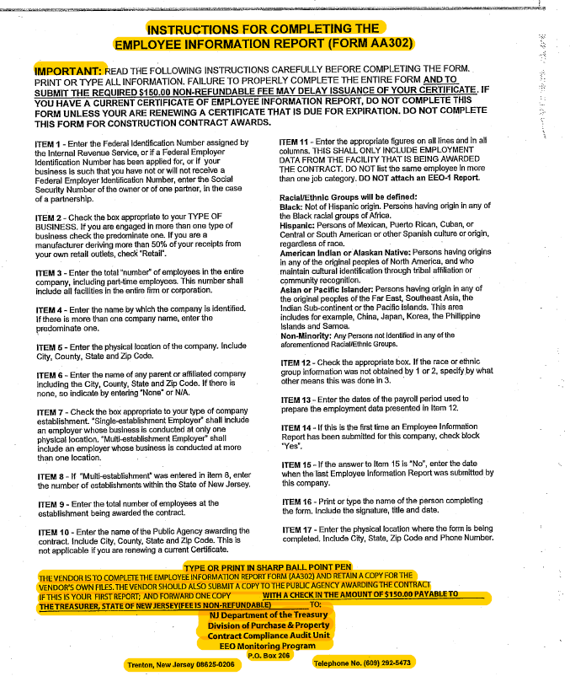
Certificate of Employee Information Report
If your organization does not have a current Certificate of Employee Information Report, you must complete the State of NJ Contract Compliance Audit Unit Employee Information Sheet and submit to the NJ Dept. of Treasury with your check for $150 for initial application, or $75 for a replacement
Do NOT send the form and check to DMHAS or with your contract documents
DO upload a copy of the completed form and a copy of your check

Slide 27
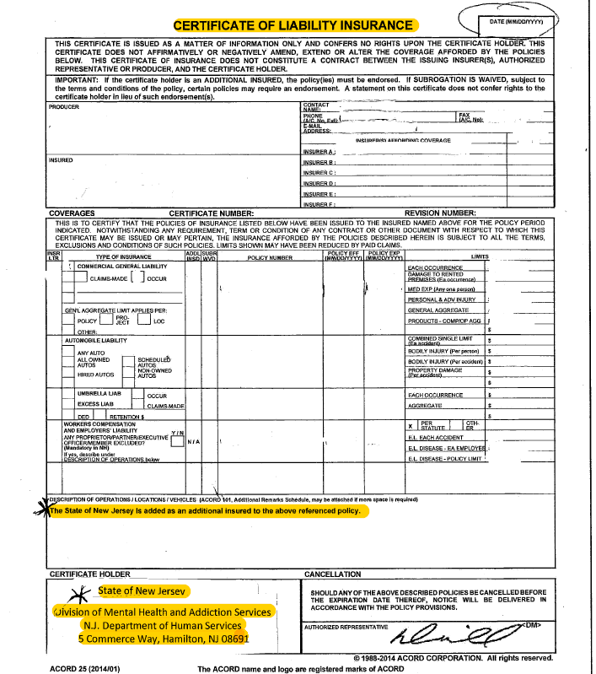
Certificate of Liability Insurance Naming NJ DMHAS
Contact your insurance agent to request a Certificate of Insurance naming NJ DMHAS as additional insured
NJ DMHAS address listed in screenshot bottom left

Slide 28
Business Registration Certificate-Sample

Slide 29
Secure FTP site upload instructions
Save all documents as a PDF in the following file naming format:
Agency Name Document
(Agency Name Agency Admin Contract Info Page SFY 2022-2023.pdf)
Login to SFTP site using login credentials via the following link: https://securexfer.dhs.state.nj.us/login
Upload documents to the Secure SFTP Site:
Select the “Add Files” button to select your files you are uploading, then select the “Start Upload” button.

Slide 30
Questions

